Slide 1
Microsoft Commercial Marketplace
Microsoft Skilling

Slide 2

Learning objectives
In this workshop, you will participate in lecture and group activities to accomplish the following items:
Accessing and navigating the Microsoft Commercial Marketplace.
Searching and deploying solutions in the Microsoft Commercial Marketplace.
Integration of procurement applications into the Microsoft Commercial Marketplace.
Microsoft Commercial Marketplace governance and permissions.
Managing purchases and setting up limits.
Notes:
Review the learning objects with the participants.

Slide 3
What to expect
This workshop includes:
This workshop does not include:
Content with documented use cases and discussion topics
Documented exercises to follow along with the instructor
Hands-on lab experience
Shared hands-on lab environment (aka OpenHack)
Lecture without interaction

Slide 4

4-Hour Workshop
9:00 | 10 minutes | Kick-off and overview
9:10 | 50 minutes | What is Microsoft Commercial Marketplace
10:00 | 55 minutes | Purchasing in Marketplace
10:55 | 10 minutes | Break
11:05 | 50 minutes | Integrating Marketplace with Procurement Systems
11:55 | 55 minutes | Setting up a Private Marketplace
12:50 | 10 minutes | Wrap-up
Agenda
Notes:
NOTE: Your start time may vary. Please fill in time zone for this delivery.
SAY:
Training is x hours long.
There are no scheduled breaks, take when needed. There is a 45-minute lunch.
Head Coach will start the workshop in the General Channel and wrap up the workshop at the end of the day in the General Channel.
The rest of the day, the students will work in their individual TEAM Channels with you as the other coaches leading them through activities and monitoring the schedule.
Coach should do a high-level walk-through of the agenda and what is happening at each of the lab modules.

Slide 5
Microsoft Commercial Marketplace Overview and Purchasing

Slide 6
Introduction
This module will help you to understand Microsoft Marketplace and purchasing solutions.
After completing this module, you’ll be able to:
Explain the use and benefits of Microsoft Marketplace.
Understand the ways to purchase solutions through Marketplace.
Use the Marketplace to purchase Azure resources.
Use the Marketplace to purchase SaaS applications.
Deploy resources and applications from the Marketplace.

Slide 7
Introduction to Marketplace (60 minutes)

Slide 8
What is the Microsoft Marketplace?
Cloud-based
On-demand
Microsoft services
Third-party Microsoft partner solutions
Independent software vendor (ISV) partners
Global system integrators (GSI) partners – for consulting and managed services
Notes:
Azure Marketplace overview - Microsoft marketplace | Microsoft Learn

Slide 9
Who uses Azure Marketplace?
Customers
Searchable tool
Trial licenses available
Easily buy and deploy solutions
Use existing Microsoft purchase agreements for consolidated invoice
Partners
Test solutions in Microsoft Azure infrastructure
Create your own offers for an additional sales and marketing channel
Reach more customers
Notes:
Azure Marketplace overview - Microsoft marketplace | Microsoft Learn

Slide 10
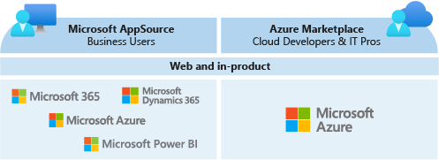
AppSource vs. Azure Marketplace
Marketplace is specific to Azure
Microsoft AppSource is for:
Azure
M365
Microsoft Dynamics 365
Microsoft Power BI
Notes:
Azure Marketplace overview - Microsoft marketplace | Microsoft Learn

Slide 11
Marketplace online store
Apps
Consulting Services
Featured solutions
Accessible through marketplace link:
https://azuremarketplace.microsoft.com/
Accessible through Azure portal link:
https://portal.azure.com
Browse, Search, or Filter to find apps or consulting services

Slide 12
Exercise – Search for Free Apps on Windows OS
Go to the Marketplace
Use the Browse apps to select IT & Management tools
Filter the Operating System to Windows
Filter the Pricing Model to Free
Find an app
Mark it as a favorite

Slide 13
Exercise – Search for Paid Apps on Windows
Go to the Azure Marketplace
Use the Browse apps to select Security
Filter the Pricing Model to Pay as You Go
Find an app
Mark it as a favorite

Slide 14
Exercise – Search for Free Consulting Services
Go to the Marketplace
1
Use the Browse apps to select Security
2
Filter the Service Types to Assessment
3
Filter the Pricing Model to Free
4
Find a consulting service
5
Mark it as a favorite

Slide 15
Exercise – Search for Paid Consulting Services
Go
Go to the Azure Marketplace
Use
Use the Browse apps to select Security
Filter
Filter the Service Types to Workshop
Filter
Filter the Pricing Model to Paid
Find
Find a consulting service
Mark
Mark it as a favorite

Slide 16
Creating Offers and Purchasing in Marketplace

Slide 17
How does purchasing work in Azure Marketplace?
Listing (Contact Me)
Free Trial
Bring Your Own License (BYOL) - Get it Now
Transaction – Get it Now
Bill to Microsoft account
Process with credit card
Link to provider CRM
Reach out to interested customers
Try before you buy
Test drive software
Use current license
Protects your existing investment in software
Notes:
Azure Marketplace overview - Microsoft marketplace | Microsoft Learn

Slide 18
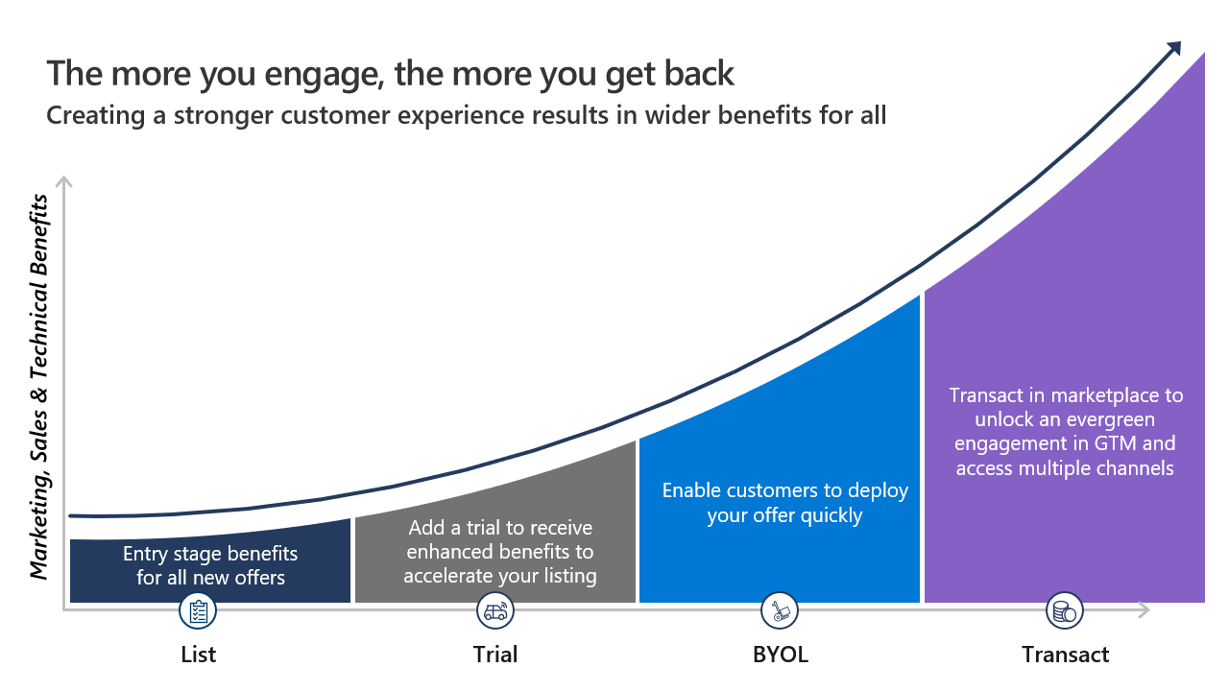
Marketplace Rewards
Published offers receive different tiers of support based on the transaction type.
https://aka.ms/joinmarketplace

Slide 19
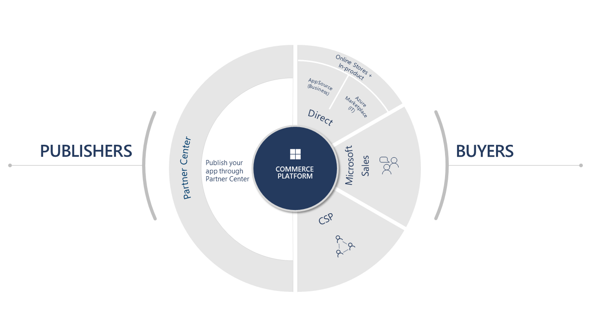
Purchasing Options
Online stores
Within Microsoft Products
Through CSP partners
Microsoft sales through co-sell
Notes:
Commercial marketplace sales channels - Training | Microsoft Learn

Slide 20
Drawing Customers to Your Listing
Free trials
Plan and pricing options
Selling through Microsoft
Notes:
Commercial marketplace sales channels - Training | Microsoft Learn

Slide 21
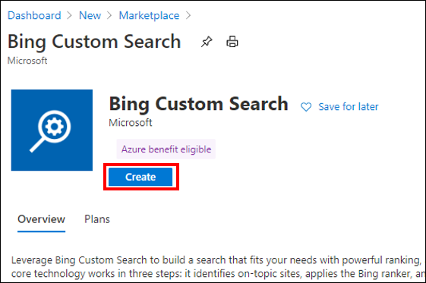
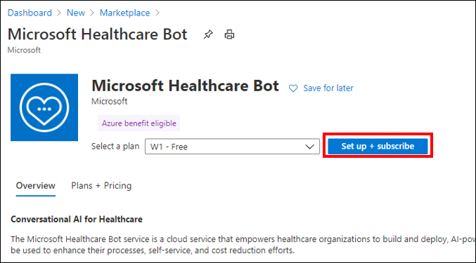
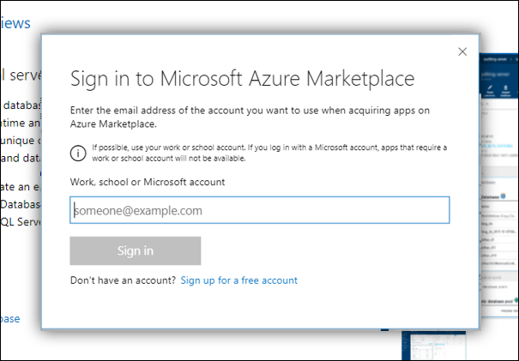
Azure Marketplace Purchasing
Simplified procurement
Credit card
Microsoft account
Permission to purchase
RBAC permissions
Subscription owner or contributor

Slide 22
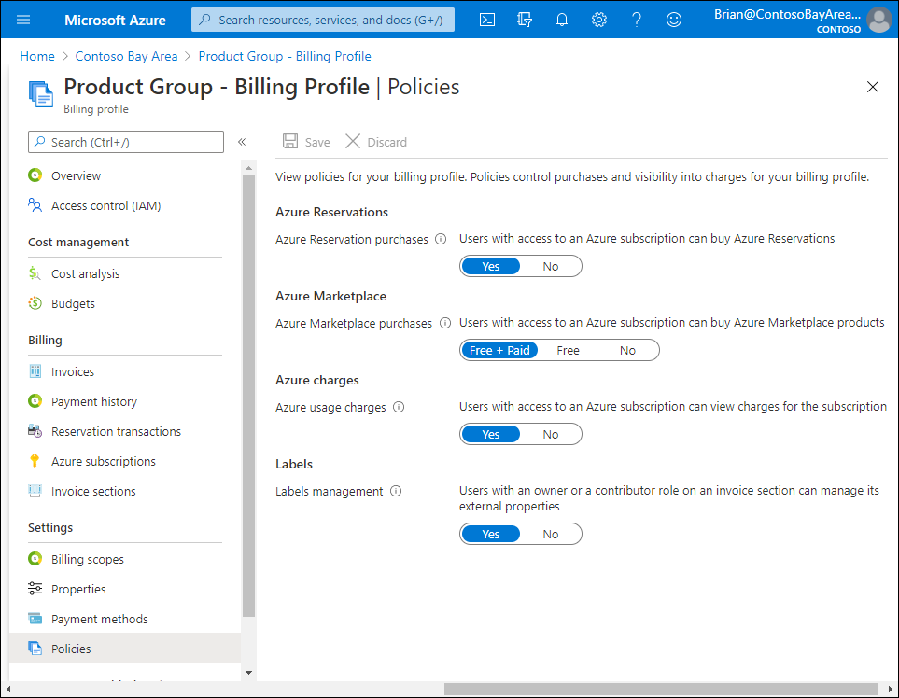
Purchase Policy Management
Purchase policy management
Azure subscription administrator manages
Billing profiles
Policies manage user purchases
Azure Reservations
Azure Marketplace
Free + Paid
Free
No
Labels

Slide 23
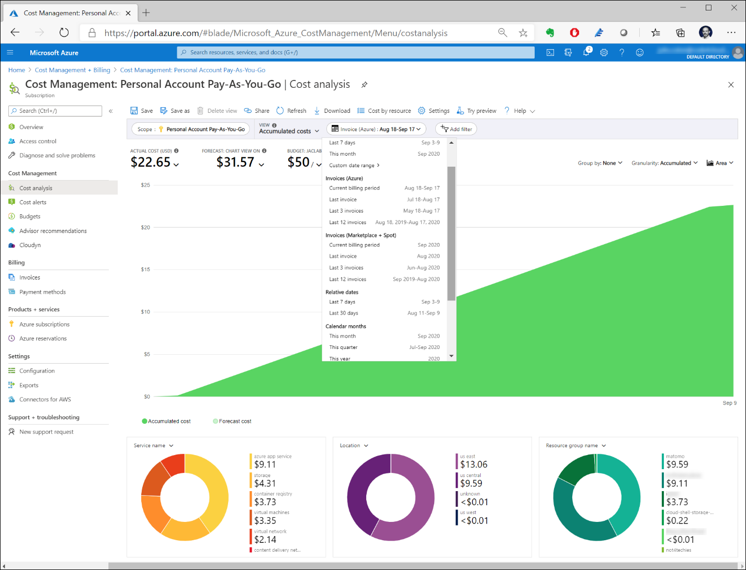
Cost Management
Cost management
Set budgets
Spending limits
Analyze costs and spending
Notes:
Purchasing software and solutions from Azure Marketplace - Microsoft marketplace | Microsoft Learn

Slide 24
Purchase Validation
Purchase validation checks
Failure to purchase reasons
Governs the policies that have been put in place
Notes:
Purchasing software and solutions from Azure Marketplace - Microsoft marketplace | Microsoft Learn

Slide 25
Purchasing Azure Application
Requirements
Have an Azure subscription
Have correct role assignment to purchase
Types of plans
Solution template (ARM template)
Managed application
Steps to purchase
https://portal.azure.com
Notes:
Commercial marketplace sales channels - Training | Microsoft Learn

Slide 26
Purchase and Deploy an Azure Application
Walk through demo
Notes:
Sign in to Azure portal at https://portal.azure.com.
Under Azure services, select + Create a resource.
In the upper-right of the page, next to Popular Marketplace products, select See more in Marketplace.
To filter the results on Azure Application offers, select the Product Type filter near the top of the page, and then select Azure Applications.
You can optionally filter the results using the following filters.
Filter group
Description
Pricing
You can filter on the following: Free – free plan, the software is provided with no additional cost, not including the cost associated with the VM instance type. Free trial - Azure virtual machine plans allow for 1, 3, or 6-month free trials. Once the free trial is over the Pay as you Go price will be charged. Bring your own license – contact the publisher to get the license for using the software Pay as you go - usage-based pricing model, can be charged per core, per core size, or per market (customer sold-to address) and core size
Publisher Type
Select Microsoft, Partners, or both
Publisher name
Filter the products based on the publisher's name
You can optionally select a category on the left-side of the page to further filter the results.
To see only offers that are eligible for the Azure benefit program, select the Azure benefit eligible only check box. To learn more about this benefit program, see Azure consumption commitment benefit.
Select the Azure Application offer you want.
If the offer has more than one plan, you can see them on the Plans + Pricing tab.
Select Create. The Create Offer Name page appears.
On the Basics tab, under Project details, make sure the subscription you want the VM for is selected. Then next to Resource group, do one of the following:
From the Resource group list, select an existing resource group.
Below the Resource group list, select Create new. Then, in the dialog box that appears, enter a name for the resource group and select OK.
Complete any remaining fields on the page, and then select Review + create. Other input fields in the Marketplace experience vary between publishers and offers. Each offer might collect different input based on it's needs.

Slide 27
Purchasing Azure resources
Requirements
Have an Azure subscription
Have permission to purchase from Marketplace
Images have different costs
Size of VM – vCores, RAM, drive space
Operating systems
Windows Server
Windows Client
Linux distributions
Steps to purchase
https://portal.azure.com
Notes:
Commercial marketplace sales channels - Training | Microsoft Learn

Slide 28
Purchase and Deploy an Azure Virtual Machine
Walk through demo
Notes:
Sign in to the Azure portal at https://portal.azure.com.
Under Azure services, select + Create a resource.
In the upper-right of the page, next to Popular Marketplace products, select See more in Marketplace.
To filter the results on virtual machine offers, select the Product Type filter near the top of the page, and then select Virtual Machine.
You can optionally filter the results using the following filters.
Filter group
Description
Pricing
You can filter on the following: Free – free plan, the software is provided with no additional cost, not including the cost associated with the VM instance type Free trial - Azure virtual machine plans allow for 1, 3, or 6-month free trials, once the free trial is over the Pay as you Go price will be charged Bring your own license – contact the publisher to get the license for using the software Pay as you go - usage-based pricing model, can be charged per vCPU, per vCPU size, or per market (customer sold-to address) and vCPU size
Operating System
Filter by the OS the VM image is using
Publisher Type
Select Microsoft, Partners, or both
Publisher name
Filter the products based on the publisher's name
You can optionally select a category on the left-side of the page to further filter the results.
To see only offers that are eligible for the Azure benefit program, select the Azure benefit eligible only check box. To learn more about this benefit program, see Azure consumption commitment benefit.
Select the VM offer you want.
If the offer has more than one plan, you can see them on the Plans + Pricing tab.
Select Create. The Create a virtual machine page appears.
On the Basics tab, under Project details, make sure the subscription you want the VM for is selected. Then next to Resource group, do one of the following:
From the Resource group list, select an existing resource group.
Below the Resource group list, select Create new. Then, in the dialog box that appears, enter a name for the resource group and select OK.
Under Instance details, do the following:
In the Virtual machine name box, enter the name you want for this VM.
From the Region list, choose the region you want.
From the Size list, select the VM size you want.
Complete the remaining fields on the page. Then select Review + create.
Purchase a VM using search
Sign in to the Azure portal at https://portal.azure.com.
In the search box, enter virtual machines.
Under Services, select Virtual machines.
On the Virtual machines page, select + Create > + Virtual machine. The Create a virtual machine page appears.
On the Basics tab, under Project details, make sure the subscription you want the VM for is selected. Then next to Resource group, do one of the following:
From the Resource group list, select an existing resource group.
Below the Resource group list, select Create new. Then, in the dialog box that appears, enter a name for the resource group and select OK.
Under Instance details, do the following:
In the Virtual machine name box, enter the name you want for this VM.
From the Region list, choose the region you want.
The Image list holds recently used images and Marketplace images to help you get started. Do one of the following:
Select a VM image from the Image list. Complete the fields and then go to step 12.
Below the Image list, select See all images to open the Marketplace experience.
You can use the left-nav to help you find the VM you're looking for. The left-nav has the following sections:
My Items – VM images created by you or shared with you. To learn more, see Store and share images in an Azure Compute Gallery.
Marketplace – Recently created products and Marketplace Private products.
Categories – You can filter Marketplace products by category.
My Images - To access VM images created by you.
Shared Images - To access VM images shared with you. To learn more, see Store and share images in an Azure Compute Gallery.
Community Images (PREVIEW) - To access VM images shared by an Azure subscription owner within their Azure subscription.

Slide 29
Purchasing SaaS applications
Requirements
Have an Azure subscription
Have permission to purchase from Marketplace
Discovery of SaaS offers through filters
Offer type
Private offers
Overview
Plans + Pricing
Usage information + Support
Ratings and Reviews
Billing models
Monthly
Annual (multi-year)

Slide 30
Private Offers
Engagement with Microsoft partner and their solution
Procuring a private offer is a three (3) step process:
1. Provide billing account ID and contact information to the partner
2. Accept the private offer
3. Purchase the private offer
Requires Entra permission for SSO to Microsoft partner solutions through user consent
Within Applications -> Enterprise applications -> Consent and permissions -> User consent settings
Select the consent setting
Save settings

Slide 31
Walk through of private offers
https://learn.microsoft.com/en-us/marketplace/private-offers-in-azure-marketplace
Notes:
https://learn.microsoft.com/en-us/marketplace/private-offers-in-azure-marketplace

Slide 32
Private Offers customer experience
https://www.youtube.com/watch?v=TANUlgLuVqI

Slide 33
Purchase and Subscribe to a SaaS offer
Walk through demo
Subscription and configuration
https://learn.microsoft.com/en-us/marketplace/purchase-saas-offer-in-azure-portal#saas-subscription-and-configuration
Notes:
Here are the steps you take to purchase a SaaS offer:
On the product page, select a plan that meets your needs, and then select Set up + subscribe.
You're redirected to the Basics tab, where you:
Define which subscription you want to use for billing. The Azure subscription that you use should have a valid purchase method defined for it. You should have the right level of permissions, or have a resource group under that subscription with the right level of permissions. The billing country/region of the subscription should be a country/region where the offer is available for purchase. Azure subscriptions without a valid payment method (for example, an MSDN subscription) can only be used to purchase free plans.
Note
The following Azure subscriptions can't be used to purchase SaaS: Student, Visual Studio Enterprise, or Free credit.
Choose or create a resource group to hold the SaaS application.
Type a name for the SaaS subscription, to easily identify it later. You can't change this name after you have purchased the SaaS subscription.
Under Plan, you'll see the plan you selected in the product details page (PDP). If you haven't made an active selection in the PDP, you'll see the default plan. You can change your selection by selecting the Change plan link. Then select the plan and billing term you want.
Note
You can only change to another plan that has the same billing term and payment option. For more information, see SaaS subscription lifecycle management.
In cases where the pricing model is per user, you'll be required to specify the number of users. The price that you see will change based on the subscription, plan, term, and payment frequency that you've selected.
Proceed to the Tags tab. Tags are key/value pairs that you can define. You place tags directly on a resource or a resource group, which helps you find your SaaS resource later on. Azure currently supports up to 50 tags per resource and resource group. Place tags on a resource at the time of creation, or add them to an existing resource.
Continue to Review + Subscribe to go through the offer and plan details.
Review the terms of use, amendments, and privacy policy of the publisher, and also Azure Marketplace.
You might be asked to add your contact details.
Review details for Basics and Tags.
Upon confirmation, select Subscribe.

Slide 34
Programmatic Deployment of Marketplace products
Prerequisites
Install Azure PowerShell module
https://learn.microsoft.com/en-us/powershell/azure/get-started-azureps
Connect to Azure with Connect-AZAccount command
Usage Information + Support
Information needed for PowerShell
Publisher ID
Product ID
Plan ID
Other deployment options
Azure CLI
Terraform
Notes:
Programmatic deployment of Marketplace products - Microsoft marketplace | Microsoft Learn

Slide 35
SaaS Subscription Management
Managing purchases depends on the method of purchase
Purchase in Azure portal, manage in Azure portal
Purchase in AppSource, manage in Microsoft 365 Admin Center
Microsoft partner solutions may be in Microsoft portals on in their own admin portal
Changing plans
Requires Owner or Contributor role permissions
Notes:
Software as a Service (SaaS) subscription lifecycle management - Microsoft marketplace | Microsoft Learn

Slide 36
Billing and Invoicing
Multiple currencies are supported
Recurring billing and auto-renew
Invoices are emailed monthly
Enterprise Agreement customers receive a combined Azure consumption and Marketplace invoice
Marketplace customers receive a bill only from Marketplace
Charges are calculated on the date of purchase

Slide 37
Summary
What you learned:
Explain the use and benefits of Microsoft Marketplace.
Understand the ways to purchase solutions through Marketplace.
Use the Marketplace to purchase Azure resources.
Use the Marketplace to purchase SaaS applications.
Deploy resources and applications from the Marketplace.

Slide 38
10 Minute Break

Slide 39
Marketplace procurement application integration and governance

Slide 40
Introduction
In this module, you’ll begin by learning how to connect procurement applications to Marketplace. You will also create a private Marketplace and setup purchasing permissions.
After completing this module, you’ll be able to:
Connect Entra ID for SSO to Marketplace with Procurement Systems.
Using Entra ID for authentication and authorization to Marketplace through Procurement Systems.
Setting up a private Marketplace.
Create purchasing permissions and resource limits.

Slide 41
Procurement and Azure Marketplace
What you need to know:
Billing accounts and subscriptions
Must be subscription owner or contributor to purchase
Azure subscriptions is consumption-based
SaaS subscription is time-based
Billing account ID is needed for private offer agreements

Slide 42
Account Settings
Two steps for purchase private offers:
Accept
Purchase
SaaS subscriptions
Completed in publisher's portal
Requires Entra ID (Azure Active Directory) permissions
Finding permissions
Marketplace private offers precheck tool (https://learn.microsoft.com/en-us/marketplace/private-offers-pre-check)
Private marketplace – product will be in the allow list
Azure policies – used to block or enforce tagging when resources are created

Slide 43
Account settings demo
In Azure portal, go to: Subscriptions > select the subscription > resource providers > filter by the word “marketplace” > make sure all three results are enabled for Azure Marketplace.
To find your billing account permissions, go to the Azure portal and select Cost Management & Billing > Billing Scopes > (select the billing account you want) > Access Management (IAM).
If you don't see the billing account you're looking for, it means you don't have permission to it (including read-only permissions). To learn more, see Billing accounts and scopes in the Azure portal.
To find if you can register third-party applications via SSO, check on Entra ID (Azure AD) menu that users can register applications (Activating your SaaS service requires SSO permissions to third party apps)
Notes:
Configure how users consent to applications - Microsoft Entra | Microsoft Learn
Procurement playbook - How to drive custom deals on Azure Marketplace - Microsoft marketplace | Microsoft Learn

Slide 44
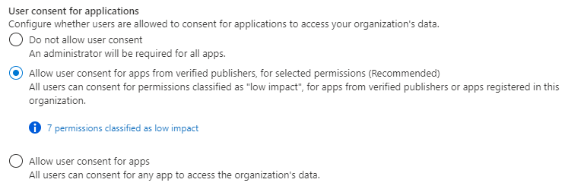
User Consent to Applications
Users need to grant permission for apps to access data
Settings can allow or deny users from granting these permissions
Configure user consent settings within Entra admin center
Prerequisites:
User account
Global Administrator role for configuration
To configure user consent settings through the Microsoft Entra admin center:
Sign in to the Microsoft Entra admin center as as a Global Administrator.
Browse to Identity > Applications > Enterprise applications > Consent and permissions > User consent settings.
Under User consent for applications, select which consent setting you want to configure for all users.
Select Save to save your settings.
Notes:
Configure how users consent to applications - Microsoft Entra | Microsoft Learn

Slide 45
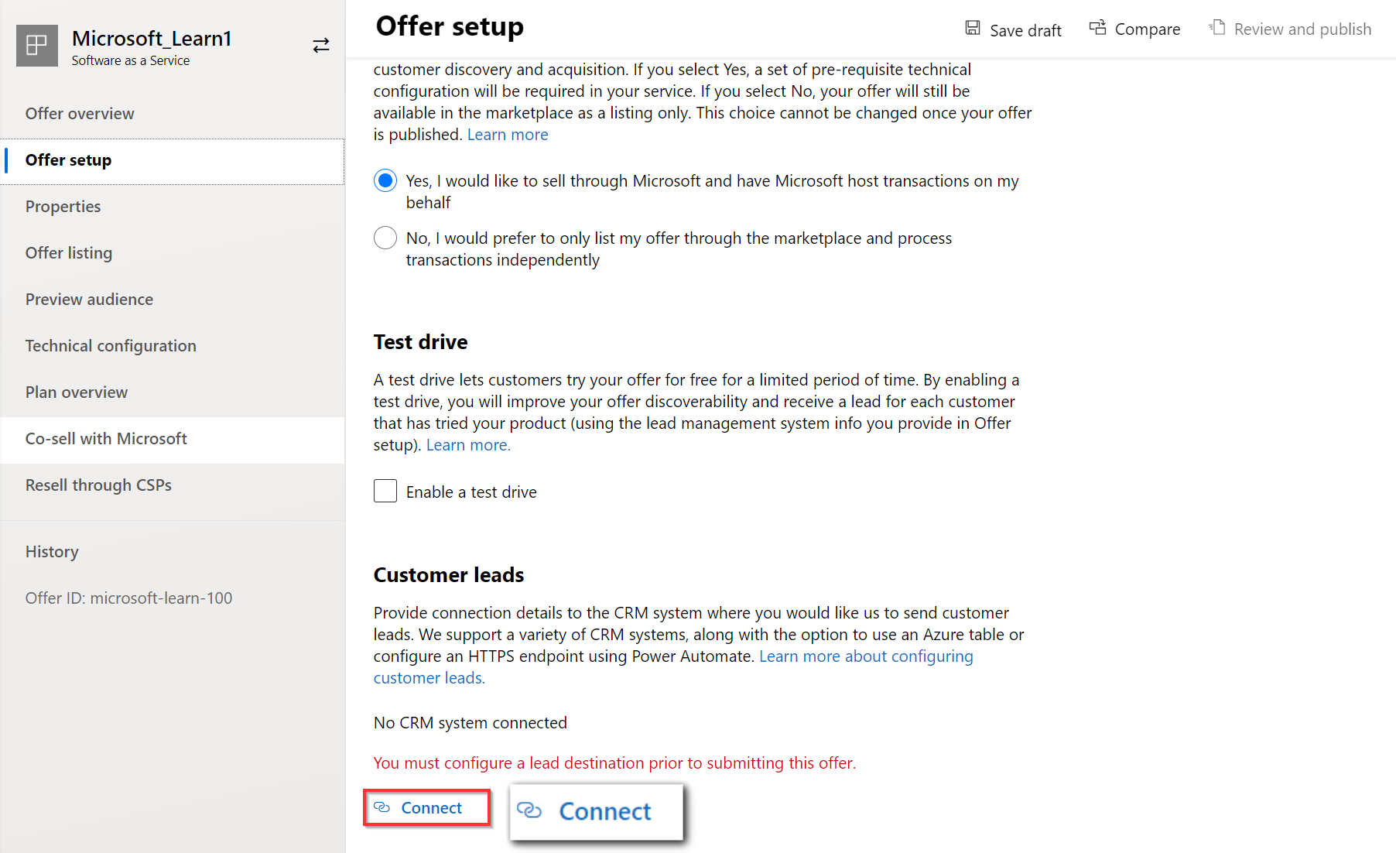
Commercial marketplace lead management
Connecting your Customer Relationship Management (CRM) system to get customer leads from your commercial marketplace offer
Offering a free trial or test drive of your offer so customers can test your solution
Integrating your software with Azure Active Directory for streamlined purchasing, fulfillment, and management of your solution for customers
Building a transact offer to provide streamlined purchases and automated distribution of your solution
Notes:
Commercial marketplace lead management - Training | Microsoft Learn

Slide 46
Procurement Solutions and Marketplace
Access to the Marketplace requires Proper Azure Credentials
Provides SSO for users
Allows users to login through SSO to Procurement systems
User governance for access to Marketplace

Slide 47
Governance and Procurement management

Slide 48
Governance and control of solutions
Avoid unrestricted access
1
Have a subset of products
2
Tailor the marketplace for organizational needs
3
Create specific offer collections at the subscription level
4
Notes:
Procurement playbook - How to drive custom deals on Azure Marketplace - Microsoft marketplace | Microsoft Learn

Slide 49
Azure Private Marketplace
Blocks products from purchase in public marketplace
Users submit requests to add a product to the allowlist
Marketplace administrator has authority to approve request
Private offers can be automatically enabled, if configured to

Slide 50
Procurement Management
Azure Marketplace Limitations
Role-based access control is within subscription
Anyone with subscription owner/contributor permissions can purchase
No "out of the box" integration with enterprise procurement or workflow
Organization must adhere to procurement policies and procedures
Must be managed externally to the Azure portal
Examples: Identifying who authorizes purchases
Established approval hierarchies
Determination of who executes purchase

Slide 51
Private Marketplace Workflow
Private Marketplace offers some control over individual purchase
Enables products to be available for purchase when needed
Procedural approvals allow products to be made available by marketplace administrator
Notes:
Procurement playbook - How to drive custom deals on Azure Marketplace - Microsoft marketplace | Microsoft Learn

Slide 52
Private Marketplace demo
Walk through exercise
Create and manage Private Azure Marketplace collections in the Azure portal - Microsoft marketplace | Microsoft Learn
Notes:
Create and manage Private Azure Marketplace collections in the Azure portal - Microsoft marketplace | Microsoft Learn

Slide 53
Summary
What you learned:
Explain how to Integrate Azure Marketplace with Procurement Systems.
Understand the ways to Integrate of Entra ID to Procurement Systems.
How to Set up a Private Azure Marketplace.
How to Create purchasing permissions and resource limits.

Slide 54
Thank you!

